Slide 1


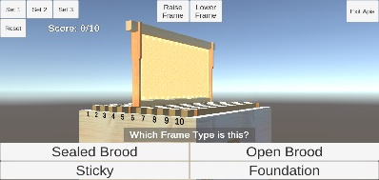
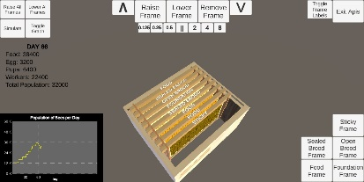
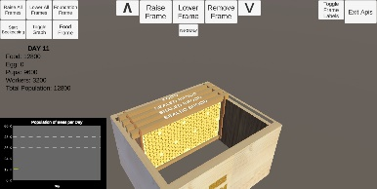
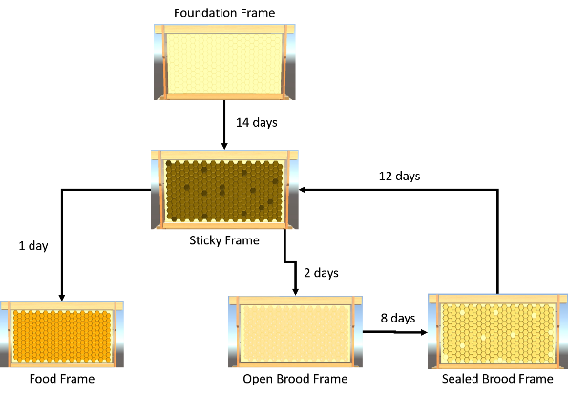
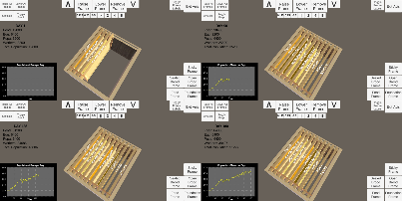
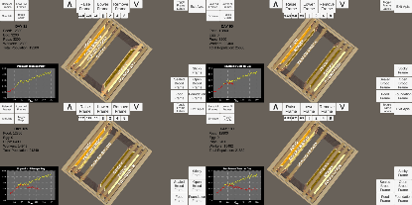

3D Mobile Simulation Application for Learning Seasonal Beehive Management
Albert Dominic Crisostomo and Prof. Arian J. Jacildo
ABSTRACT
The UPLB Bee Program offers the Intensive Beekeeping Course in which beekeeping experts teach the fundamentals of honey bee rearing, beehive management, and efficient production of honey. The objectives of this study were to provide another way to teach the fundamentals and explore mobile technologies by developing a mobile simulation application. A working mobile simulation application was developed, and was successful in rendering 3D models of beehive elements. Automatic beekeeping simulation was also developed along with the manual beekeeping. A quiz mode was developed to facilitate quizzes about frame types for users. It has simulated both proper and improper seasonal beehive management, and provided interactive quiz sets for users.
INTRODUCTION
RESULTS AND DISCUSSION
The UPLB Intensive Beekeeping Course in particular uses a combination of lectures, demonstrations, laboratory and field work, and video showing, and maintains the hands-on activities as comprising bulk of the Course. There were attempts in the past to develop a 3D simulation of seasonal beehive management. All of them were developed only for desktop computers.
Blender was used in creating the 3D models such as the wired frame and the Langstroth boxed hive, based on the specifications provided by the UPLB Bee Program. The game engine Unity3D was used in developing the simulation app. C# was the programming language used for implementing the simulation logic and other back-end functionalities. Fig. 5, Fig. 6, and Fig. 7 show different interactive modes in the mobile app.
Fig. 1. Serrano’s Simulation Tool
Fig. 2. Clariño’s Simulation Tool
Fig. 5. Use case of Quiz mode
Fig. 6. The Automatic Beekeeping mode
METHODOLOGY
The elements identified for the simulation are the frames, bees, and boxed hive. The frames are where bees form the honeycombs. The boxed hive is where all the frames will be placed in. The bees are the ones gathering food, feeding the brood, and creating sticky frames. Fig. 3 and Fig. 4 show different stages of a frame and a process flow for proper seasonal beehive management, respectively.
Fig. 7. The Manual Beekeeping mode
The simulation demonstrated proper seasonal beehive management as seen in the graphs in Fig. 8. It also simulated the outcome of improper management as shown in the graphs in Fig. 9.
Fig. 8. Proper seasonal beehive management
Fig. 9. Improper seasonal beehive management
Fig. 3. Life cycle of a frame
CONCLUSION
START
The researcher was able to create 3D models of the equipment used for beekeeping. The researcher was successful in developing a working mobile simulation application about proper seasonal beehive management. Multiple scenes were also developed to cater for different purposes of using the mobile simulation app, such as the Quiz, Automatic Beekeeping, and Manual Beekeeping.
Make nucleus colony
Place Foundation frame
Place Food frame
Frames == 10?
N
Place Brood frames in relative center
Albert Dominic Crisostomo is an undergraduate student under the BS Computer Science program of the University of the Philippines Los Baños. He loves playing video games and aspires to be a game developer.
Y
Place new Sticky frames in relative center
Too little food?
N
Frames == 10?
Y
END
Fig. 4. Flowchart of proper seasonal beehive management

